Slide 1
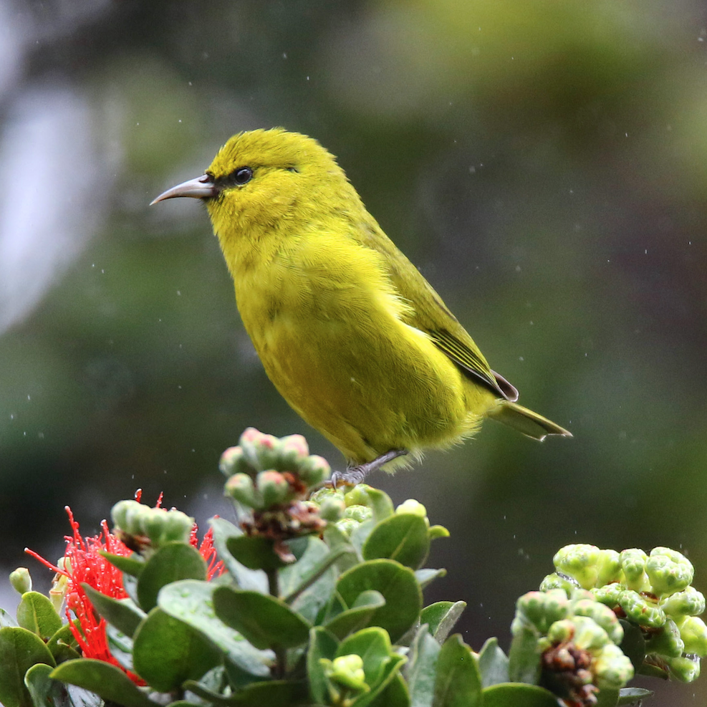
Avi Audio: Bird Species Identification by Sound
Notes:
Rare birds - not enough people, places not accessible
Audio processing task

Slide 2
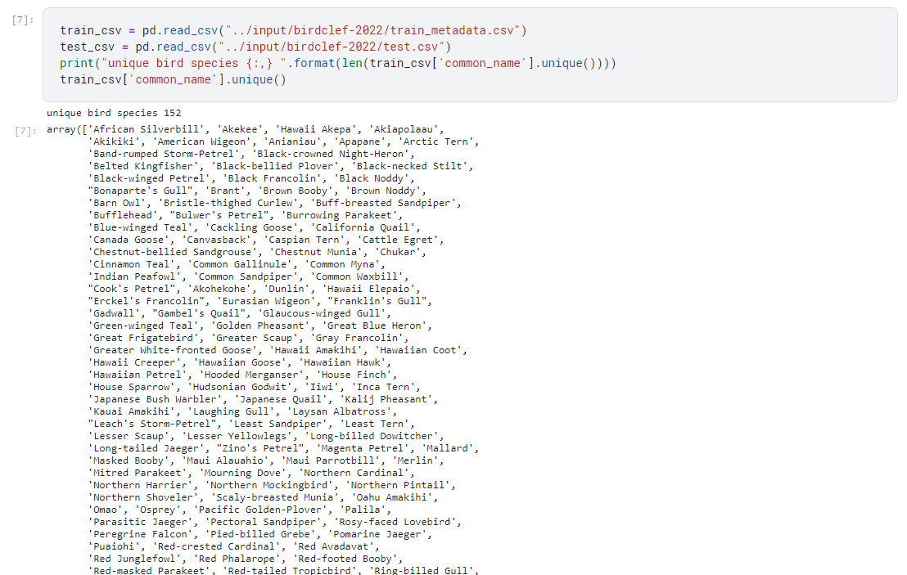
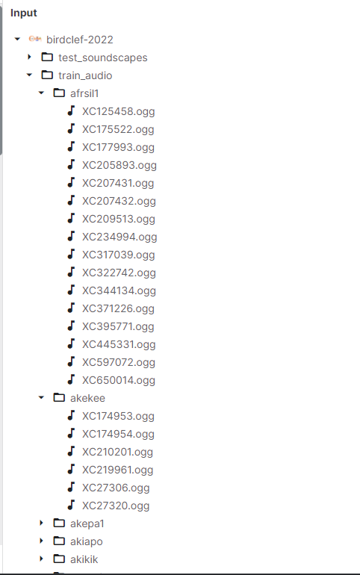
Unique Birds - 152

Slide 3
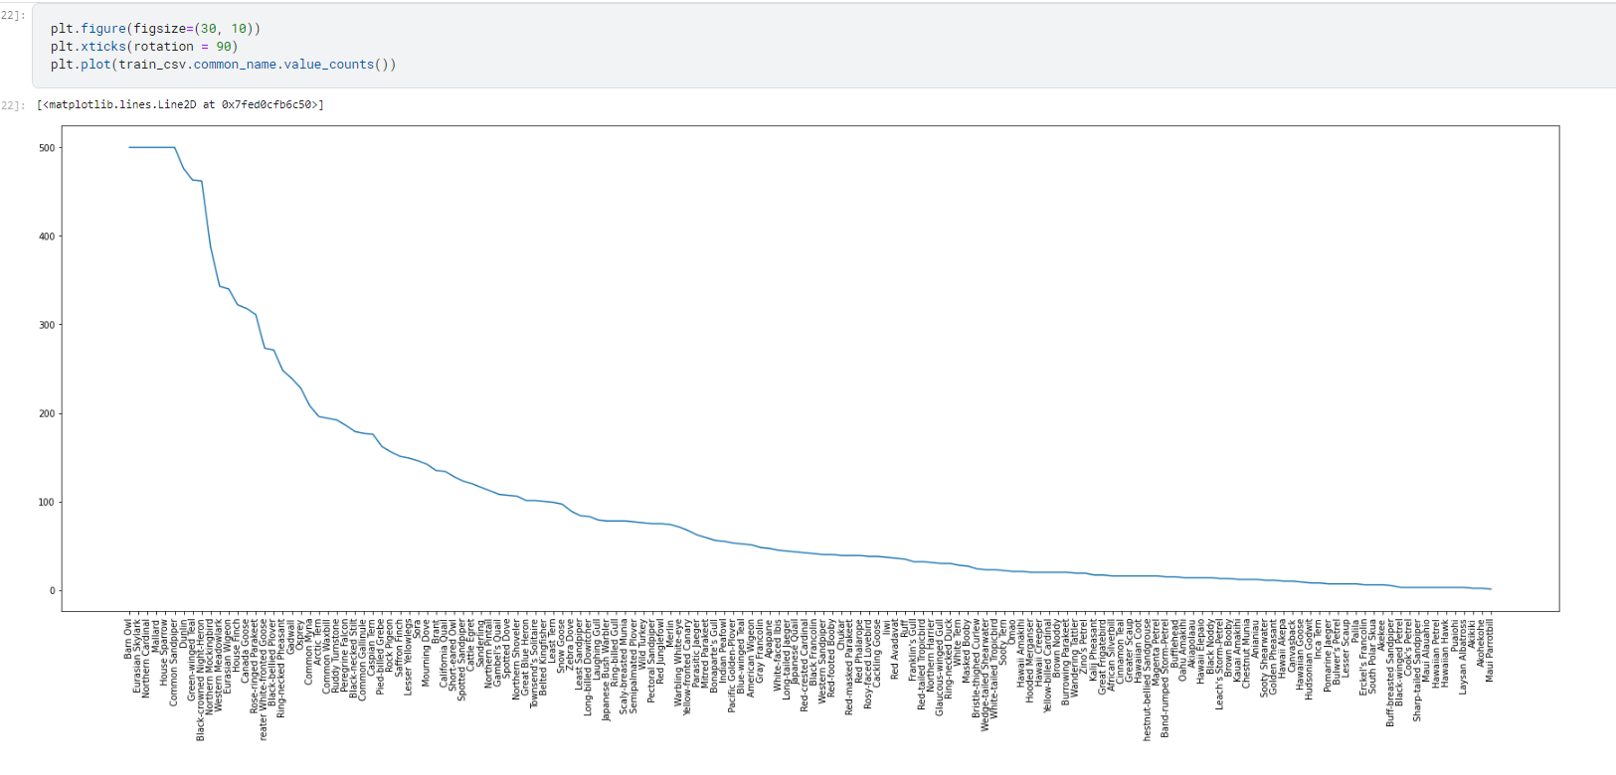
Distribution

Slide 4
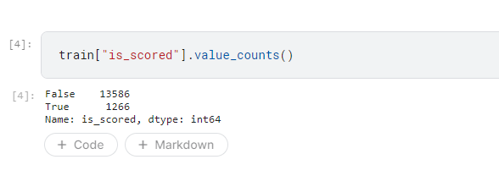
Test set is to classify between these birds?

Slide 5
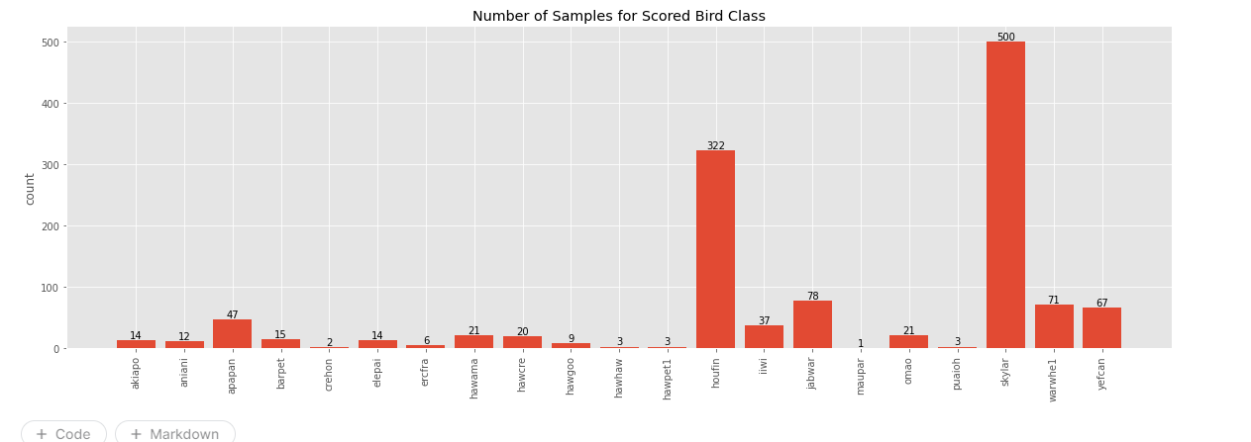
Distribution of scored birds

Slide 6
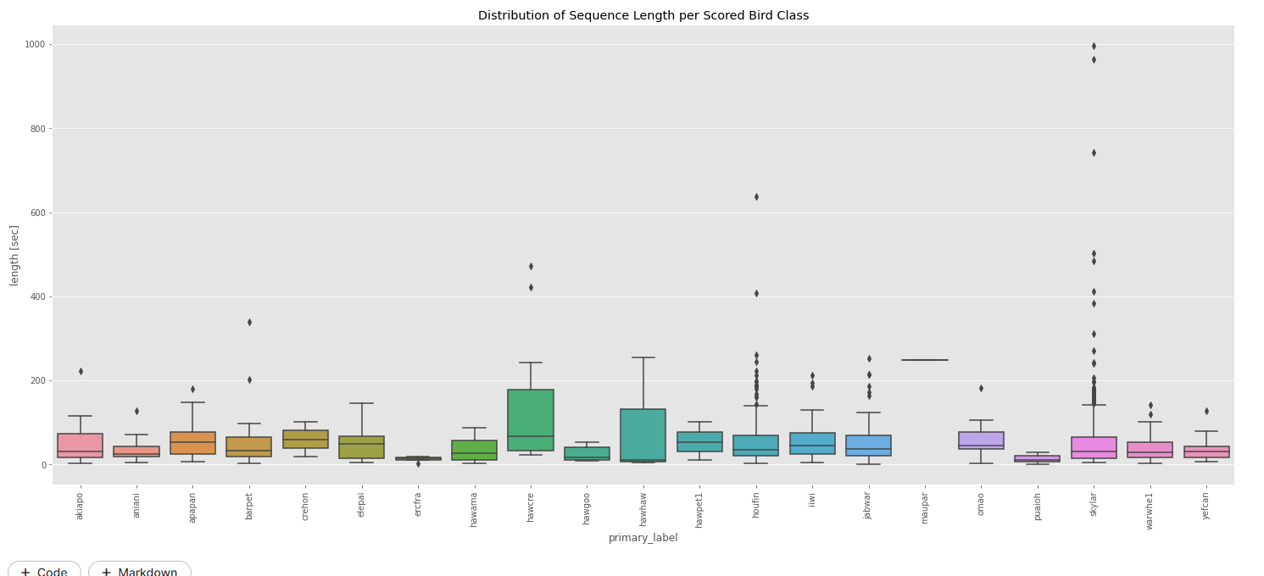
Duration

Slide 7
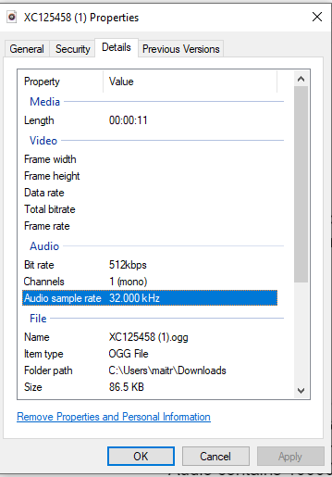
Train Set - Metadata

Slide 8
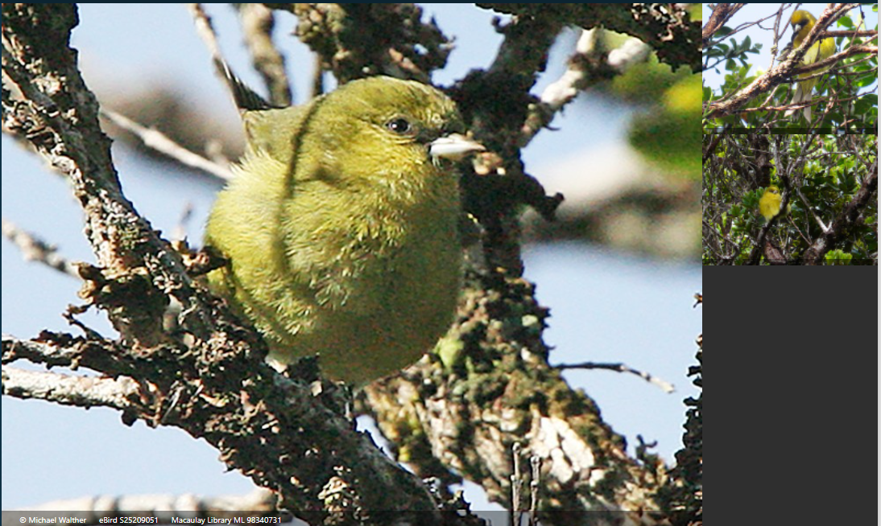
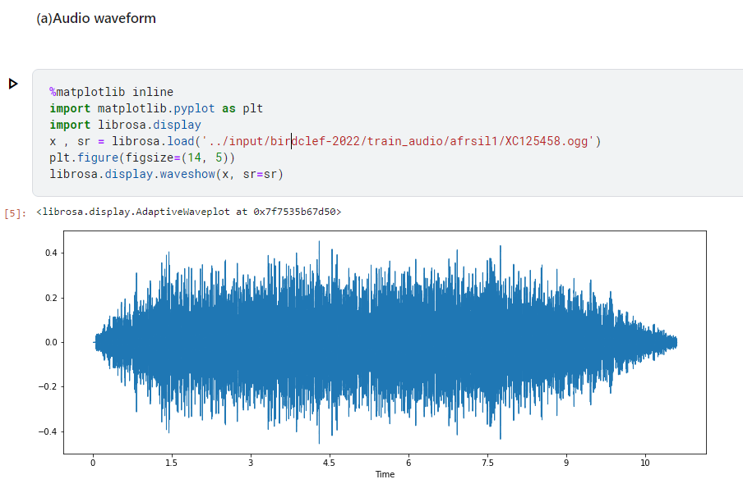

Train Sample

Slide 9
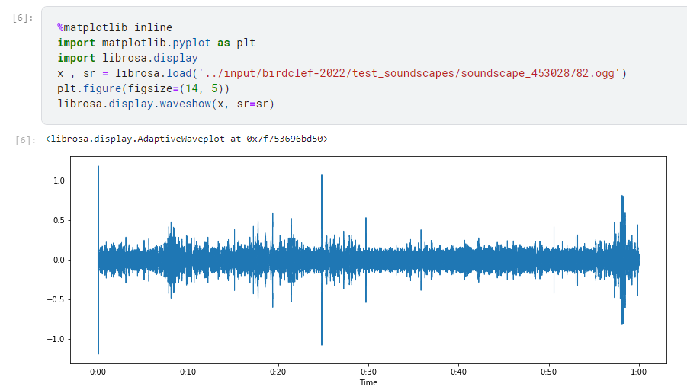
Test Set
Duration: few milliseconds of 1 minute long

Slide 10
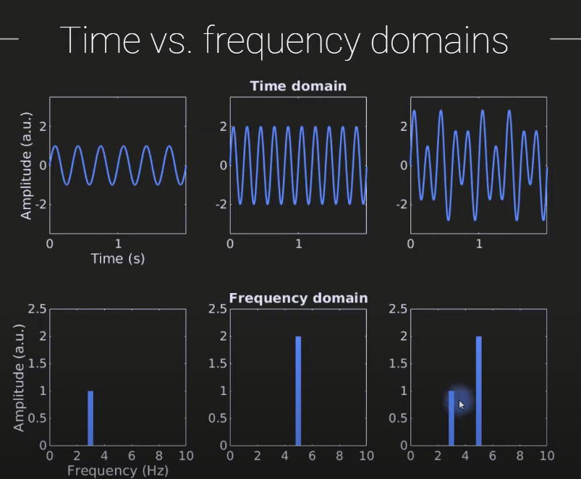
Observations
Rhythmic, narrow band components
Want to improve signal to noise characteristic
https://www.youtube.com/watch?v=fYtVHhk3xJ0

Slide 11
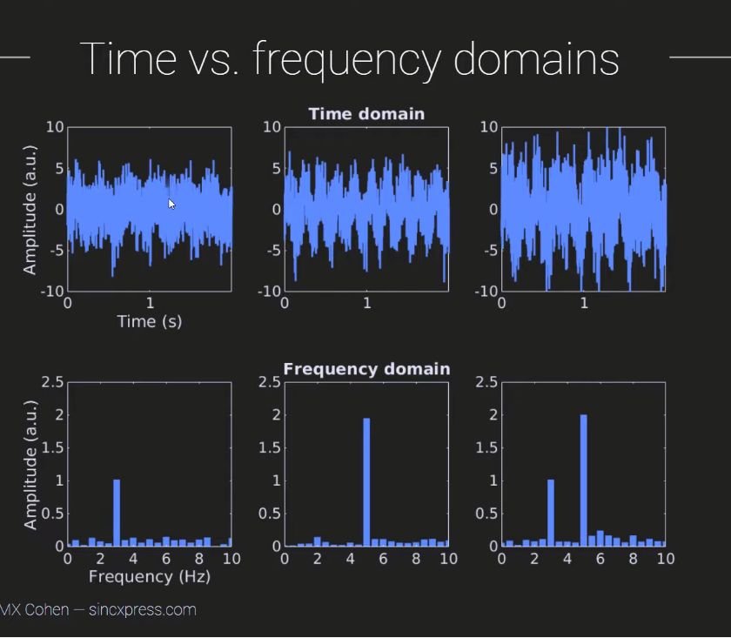
https://www.youtube.com/watch?v=fYtVHhk3xJ0

Slide 12
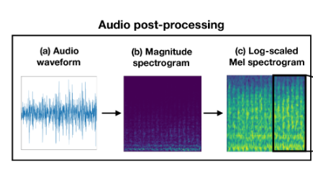
Preprocessing High Level

Slide 13
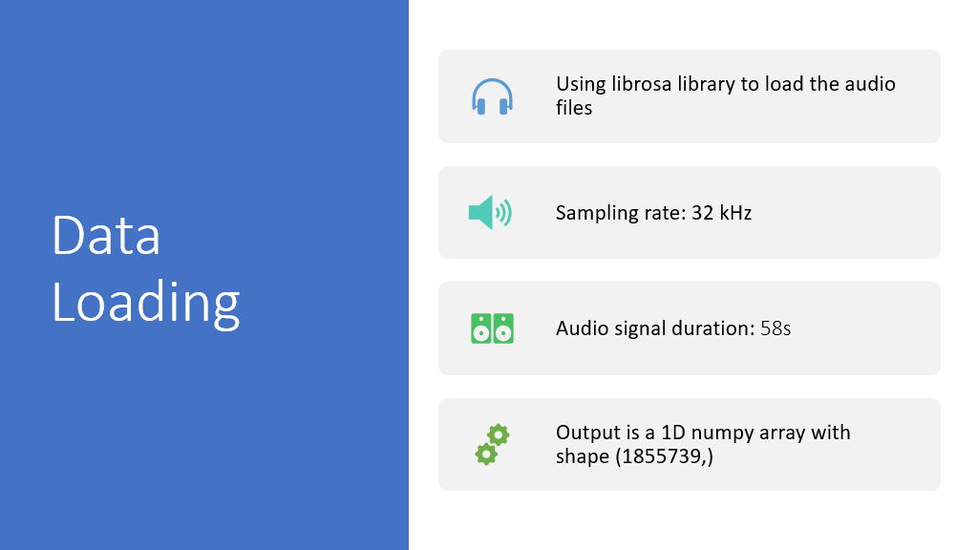
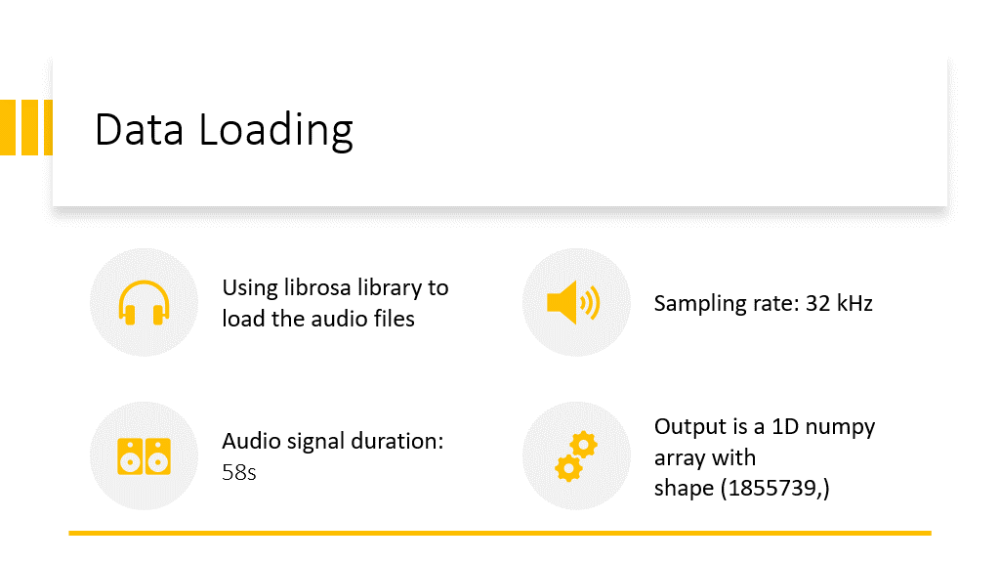

Slide 14
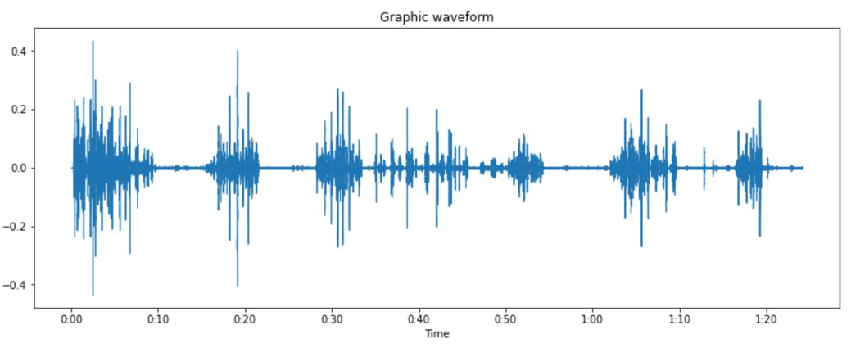
Data Visualization
Sound wave

Slide 15
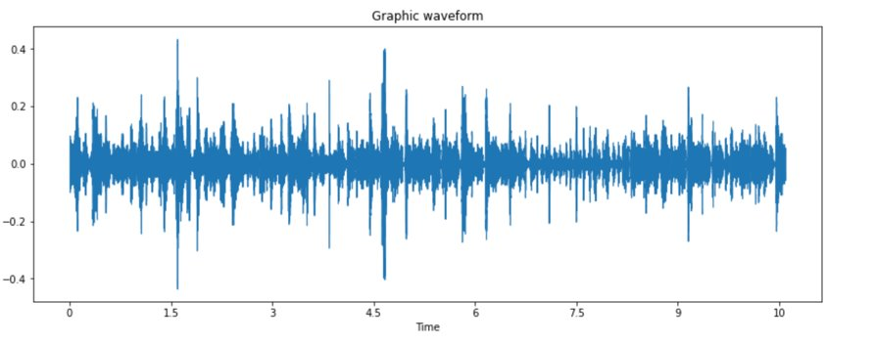
Data Cleansing
Removing the silent intervals using the librosa function: librosa.effects.split()
Output shape: (233548,)

Slide 16
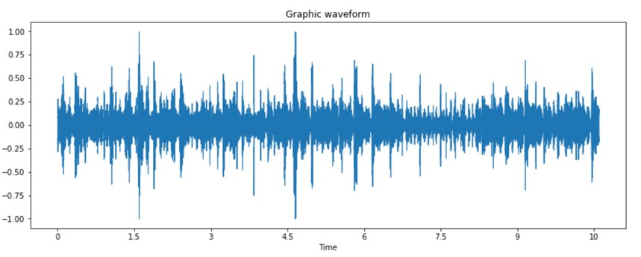
Data scaling
Used min max scaling
Numpy array shape: (233548,)

Slide 17
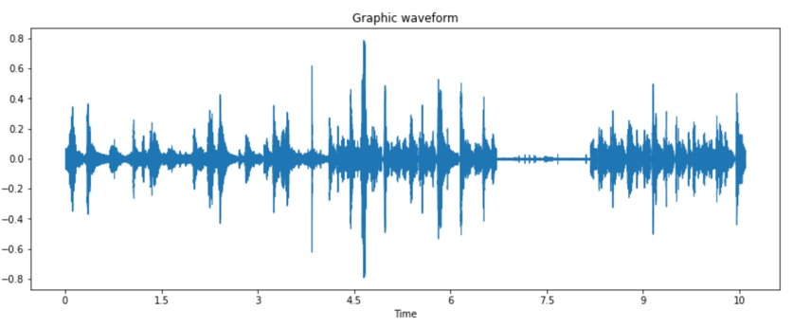
Data Preprocessing
Using bessel digital filter from scipy library to filter out the low frequencies
Output array shape: (233548,)

Slide 18
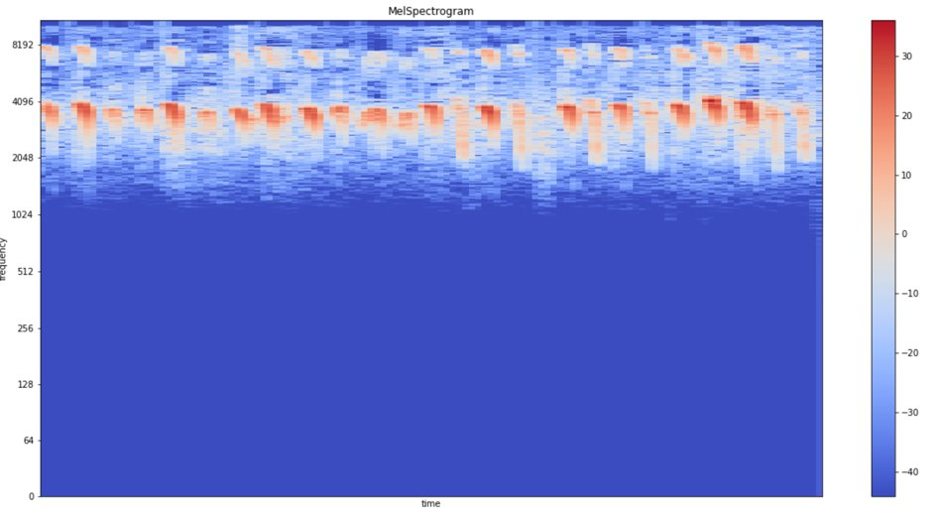
Spectrogram

Slide 19
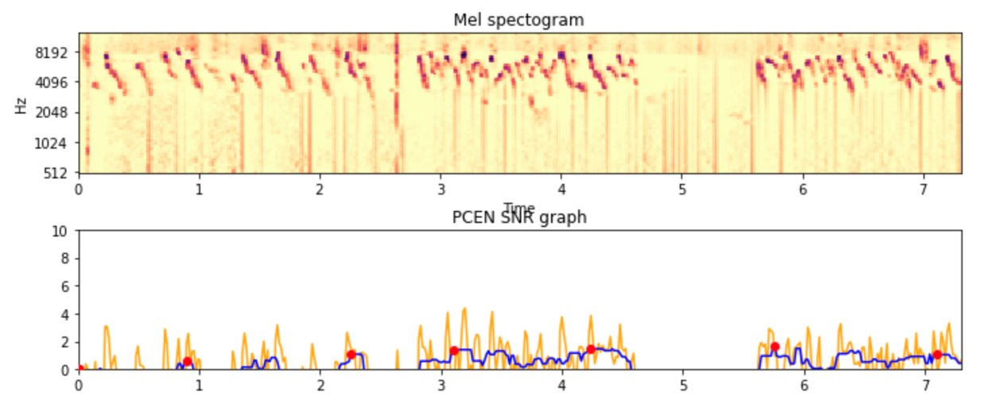
Peak Sampling
Obtained the spectrogram using the librosa melspectrogram
Obtained the energy distribution of the signal using the librosa PCEN
Obtained the peak points by getting the Signal to Noise ratio

Slide 20
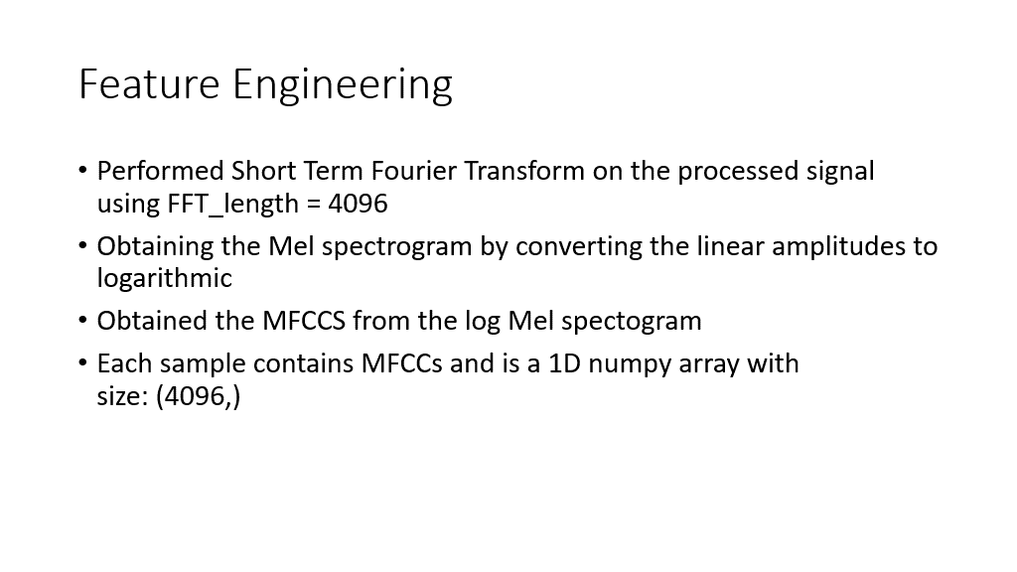

Slide 21
Prime Concept of the Densenet
DenseNet (Dense Convolutional Network) is an architecture that focuses on making the deep learning networks go even deeper, but at the same time making them more efficient to train, by using shorter connections between the layers.
In DenseNet, each layer obtains additional inputs from all preceding layers and passes on its own feature-maps to all subsequent layers. Concatenation is used. Each layer is receiving a “collective knowledge” from all preceding layers.
The Reason of choosing the densnet over the other networks was, since there is a longer path between the input and output layers there is a problem of information loss(information vanishes). So densnet improves the accuracy which is declined by using the vanish gradient by keeping all the layers interconnected to each other, using layer concatenation operation.

Slide 22
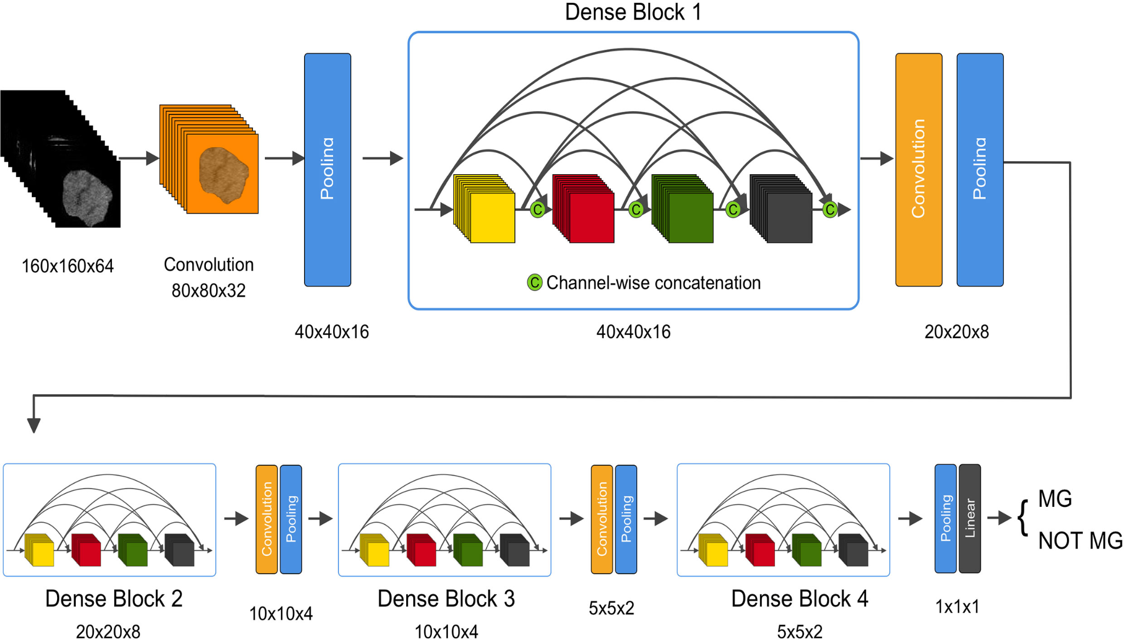
Prime Concept of the Denset Model:

Slide 23
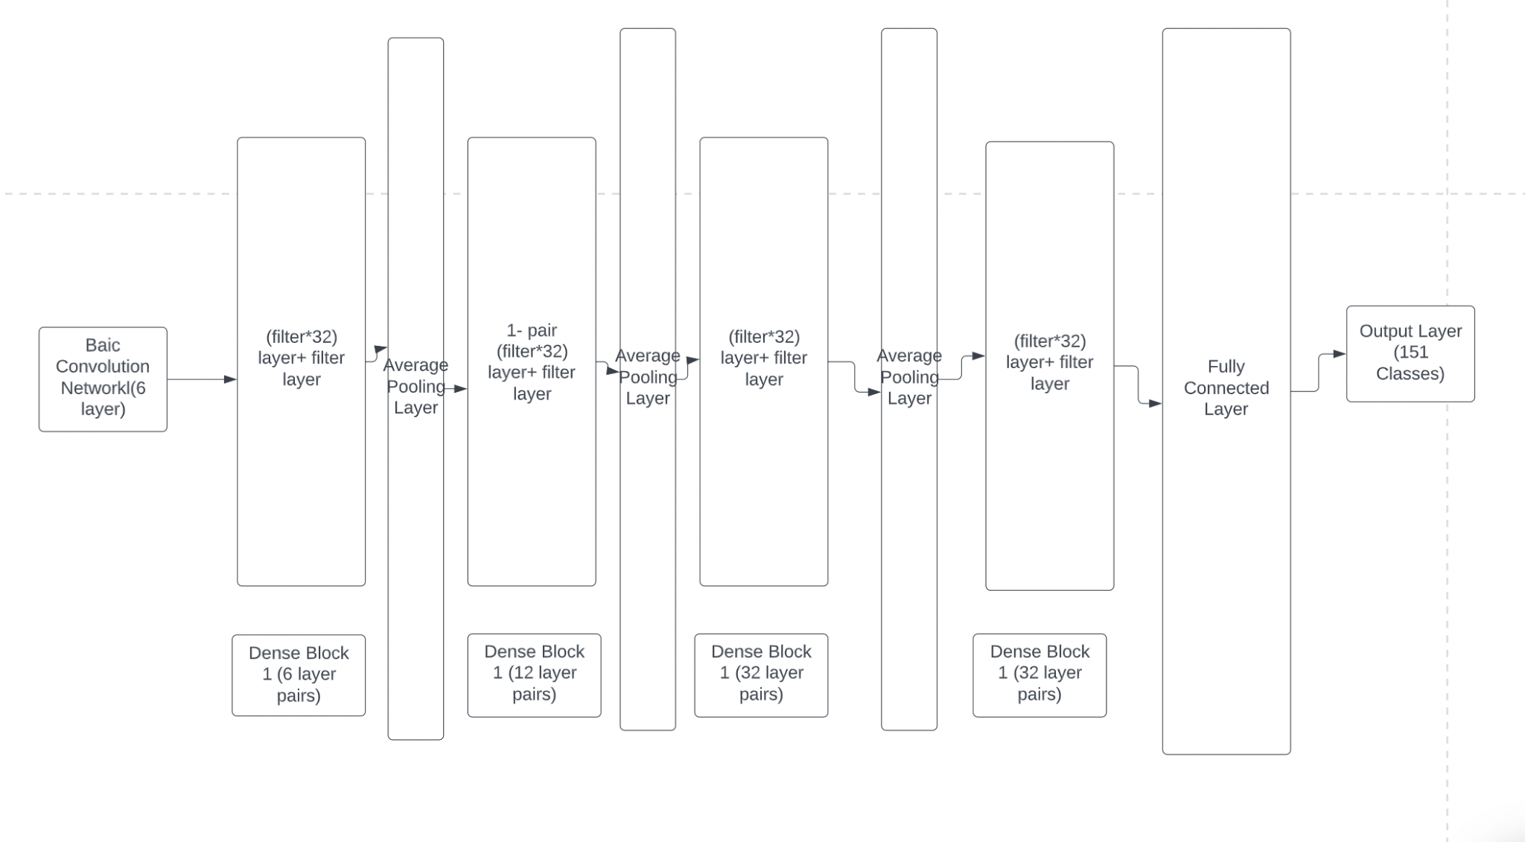
Dense Net Model :

Slide 24
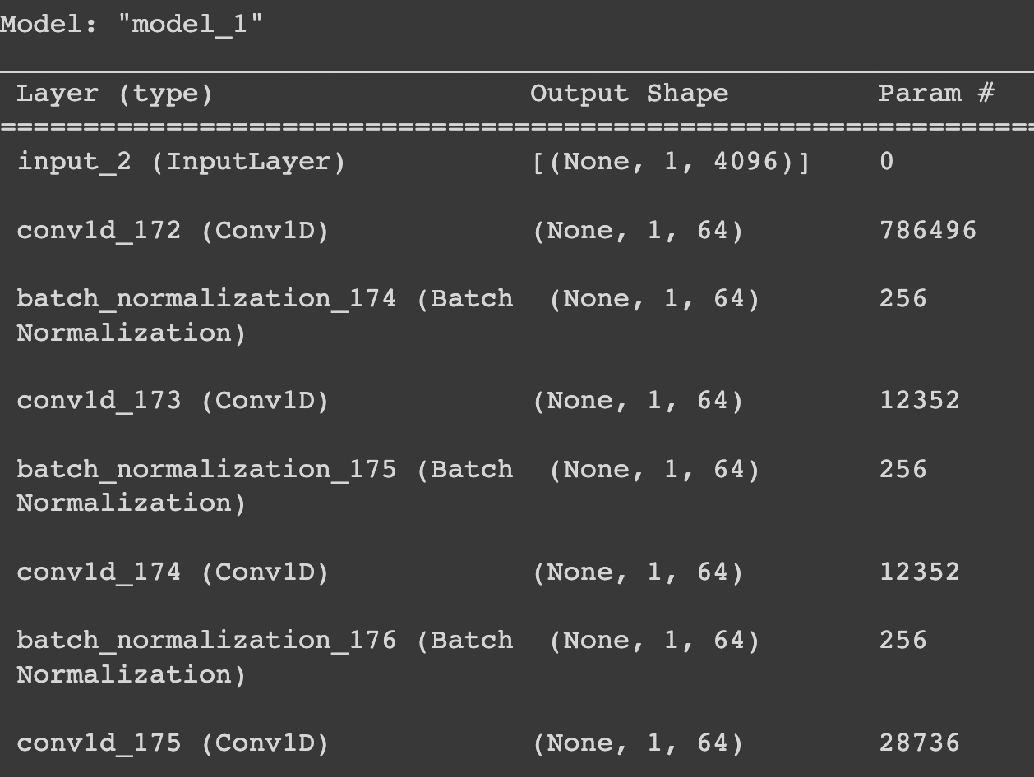
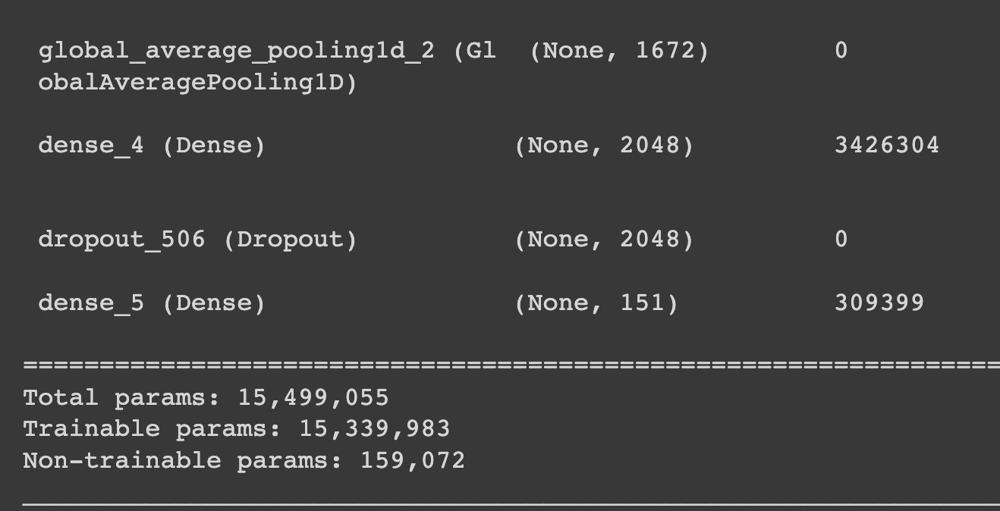
Model Summary

Slide 25
Convolution Layer block:
The layers in the convolution layer block:
Batch Convolution Layer.
Relu layer.
Convolution Layer.
Dropout Layer.
The shapes we are feeding the network:
1.Input Shape:(1,4096).
2. Output Classes(151)
3. The Number of trainable Parameters: 15,073,613

Slide 26
Parameters In the Layers:
Filters :-
In the layer pairs the filters for the alternative layers are (filter=filters*32), for the second layer the (filter-filter)
Strides:-
For the strides in the average pooling layer with the strides=2. To create a downsampled feature map.

Slide 27
Model details
Model | Batch size | Epochs | Optimizer | Loss function | Learning rate
Densenet | 274 | 8 | Adam | Categorical cross entropy | 0.001
Densenet (no preprocessing) | 128 | 150 | Adam | Categorical cross entropy | 0.001
Transfer learning | 32 | 150 | Adam | Categorical cross entropy | 0.001/ 0.01
Notes:
Categorical cross entropy?
a loss function used for multi-class classification. It is a measure of how distinguishable two discrete probability distributions are from each other. So a given class will belong to another with prob 1 and to the rest of the classes in the group with prob 0. In our models we have one-hot encoded inputs and we have multiple classes involved hence this function. 2) Adam optimizer? Optimization technique that incorporates a combination of two gradient descent techniques (Momentum & RMS Prop) to help the algorithm reach minima faster. We used because the size of the data is large so Adam will work faster than SGD.
Batch size, why the diff? Too large of a batch size will leave to poor generalization (dk why). So we started with a smaller batch size and then kept increasing the batch size at the cost of computation to see if we could get better results

Slide 28
Evaluation
The recognition of the bird noise is evaluated for 5 second samples
The evaluation is done for every such sample that belongs to an audio file
There are 21 labelled classes. Each sample is tested against a class
The metric used for evaluation is Macro F1 Score.

Slide 29
Result Analysis
Number | Model | Macro F1 score
1 | Densenet | 0.69
2 | Densenet (no preprocessing) | 0.48
3 | Transfer learning | 0.20
Notes:
Macro F1 score = arithmetic or unweighted mean of the F1 scores for all labels

Slide 30
Future work
The problem was to identify the calls of rare birds. But the data for rare birds is not readily available. Hence,
More sophisticated models involving transformers can be used
Utilizing more augmentation techniques like Random Power, Mixup, White and Pink Noise, etc.

Slide 31
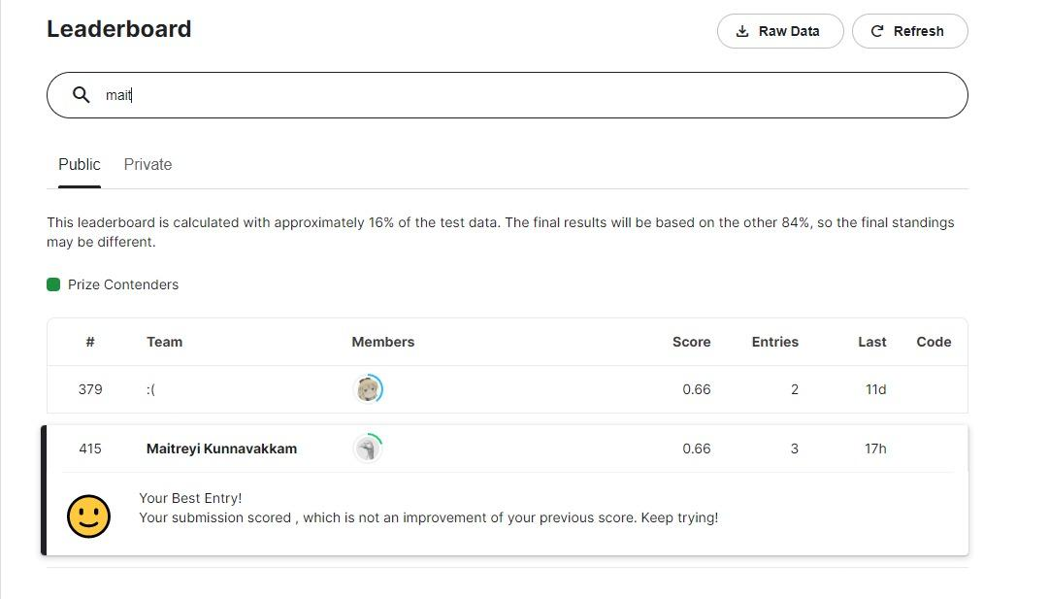
Kaggle Ranking

